Slide 1
Where does the internet come from?

Slide 2
Internet cables
https://www.submarinecablemap.com/#/submarine-cable/seamewe-3

Slide 3
Aussie internet pain after Asian subsea cables cut
https://www.itnews.com.au/news/aussie-internet-pain-after-asian-subsea-cables-cut-472070

Slide 4
All the undersea cables that power the internet
https://www.youtube.com/watch?v=9rlUPWpLWOw

Slide 5
Another map of the cables
https://www.submarinecablemap.com/#/submarine-cable/seamewe-3

Slide 6
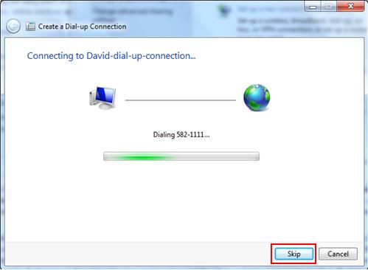
How the internet sounded when I grew up…
Dial up
https://www.youtube.com/watch?v=GSRG0TqxLWc

Slide 7
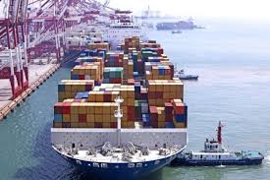
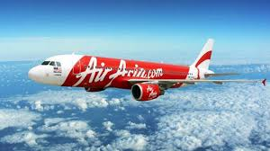
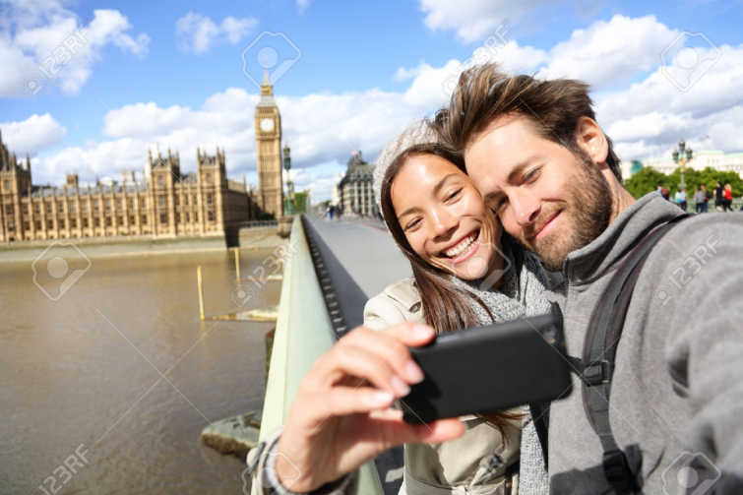
Transport Innovations Shrinking World………….
Year 9

Slide 8
Advances in transport systems
1. Advances in our transport systems have occurred because of:
Technology
Science
2. These improvements have enhanced our connection between:
People
Places
Result of improved transport systems?
Explosive growth in:
International tourism
World trade

Slide 9
As a result of the innovations in transport, people have been able to take advantage of:
Decreased travel costs
Increased capacity (passenger loads)
Improvements in safety and reliability
Increased travel and transport speeds
Greater comfort and convenience
Increased fuel efficiency
Declining environmental impacts ie. noise & air pollution
Low cost, same day, next day deliveries

Slide 10
Transport Innovations
Significant Transport Innovations:
1.
Railway: high speed “bullet” trains.
These trains travel over 400kms per hour
Japan, China, France, Germany, Italy, South Korea and Spain all have high speed trains.

Slide 11


Slide 12
Transport Innovations
Significant Transport Innovations:
2.
Megaships: vast sea vessels
Cruise ships, container ships, bulk carriers
Transport people
Raw materials
Manufactured goods
High speeds, low costs
Link sites of production and consumption

Slide 13
Transport Innovations
Significant Transport Innovations:
3.
Aircraft: High capacity aircraft
Boeing 747, Airbus 380
Can carry 853 people for 15,400kms at 900kms per hour without refuelling
Reducing cost of travel results in higher rates of tourism

Slide 14
Flight tracker
Flightrader24
https://www.flightradar24.com/-32.05,115.89/2
Where are the main areas people are flying to?
Where are they not flying?

Slide 15

Shrinking World
So what does a “Shrinking World” actually mean?
It does not mean that the world is actually getting smaller! Consider: the degree to which innovations of technology and transportation have impacted the speed of interconnection of people, communication, goods and services. It takes far less time so the world has “shrunk”.
1. Innovation in technology:
The world appears to be smaller than it actually is because we can access people and information with the touch of a button through technology.
Compare a letter posted to a text.
2. Innovation in transportation:
The world appears to be smaller than it actually is because we can travel at faster speeds, more cheaply and frequently.
Compare a horse and wagon to a bullet train.

Slide 16
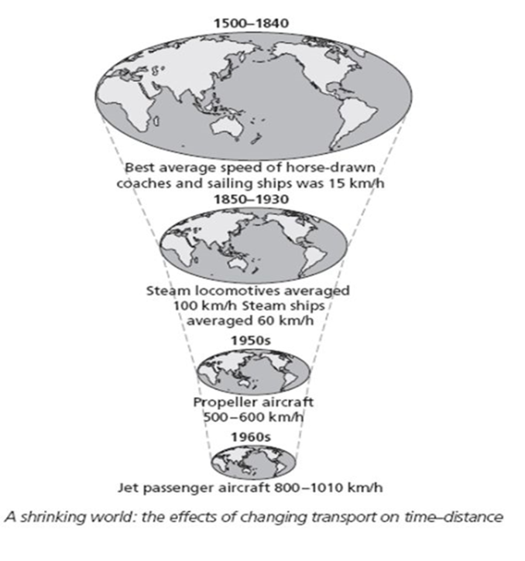

Slide 17
Questions………………
Up until 500 years ago no one had ___________________ the globe.
Why does the world seem like such a smaller place today?
How many days does it take humans to go to the moon?
Who was the first person to circumnavigate the globe?
Between 1857 -1930 the time it took to cross the USA reduced from 3 weeks to _________?
In the future where are humans looking to travel?

Slide 18
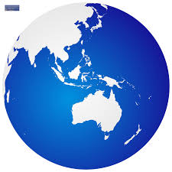
The World is Shrinking
https://www.youtube.com/watch?v=Nn-ym8y1_kw

